Slide 1
Difficulties of Timestamping Archived Web Pages
Mohamed Aturban, Michael L. Nelson, and Michele C. Weigle
Dept of Computer Science, Old Dominion University, Norfolk, VA, 23529
Naga Vamsi Krishna Pabbisetty
FEB-27-2019

Slide 2

WEB ARCHIVING
Archives
Memento
Timestamp and Its Need

Slide 3

BLOCKCHAIN AND THE GENERATION OF CRYPTOGRAPHIC HASHES
Timestamping in Block Chain
Hash and Aggregated Hash
Bitcoin Address
Repeatable Hash Values
Proof of Work and other upcoming changes in Bitcoin Networks

Slide 4
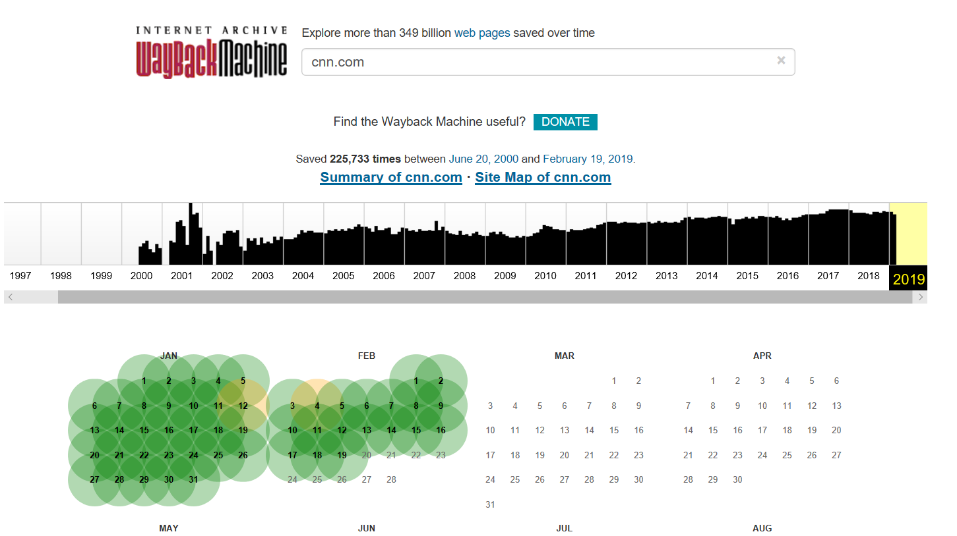
What is TimeMap ?

Slide 5
Issues in Generating Cryptographic Hashes of Mementos

Slide 6
Generating Hashes on HTML pages(smaller pages)
MacBook-Pro:WA nagavamsikrishnapabbisetty$ curl -s http://wsdl-maturban.cs.odu.edu:11011/michael/wayback/20170717185130/https://climate.nasa.gov/vital-signs/carbon4 dioxide/<!DOCTYPE html PUBLIC "-//W3C//DTD XHTML 1.0 Transitional//EN" "http://www.w3.org/TR/xhtml1/DTD/xhtml1-transitional.dtd"><html><head><meta http-equiv="refresh" content="0;url=http://finder.cox.net/main?ParticipantID=96e687opkbv4scrood8k84drs6gw5duf&FailedURI=http%3A%2F%2Fdioxide%2F&FailureMode=1&Implementation=&AddInType=4&Version=pywr1.0&ClientLocation=us"/><script type="text/javascript">url="http://finder.cox.net/main?ParticipantID=96e687opkbv4scrood8k84drs6gw5duf&FailedURI=http%3A%2F%2Fdioxide%2F&FailureMode=1&Implementation=&AddInType=4&Version=pywr1.0&ClientLocation=us";if(top.location!=location){var w=window,d=document,e=d.documentElement,b=d.body,x=w.innerWidth||e.clientWidth||b.clientWidth,y=w.innerHeight||e.clientHeight||b.clientHeight;url+="&w="+x+"&h="+y;}window.location.replace(url);</script></head><body></body></html>MacBook-Pro:WA naMacBook-Pro:WA nagavamsikrishnapabbisetty$ MacBook-Pro:WA nagavamsikrishnapabbisetty$ curl -s http://wsdl-maturban.cs.odu.edu:11011/michael/wayback/20170717185130/https://climate.nasa.gov/vital-signs/carbon4 dioxide/ | md5
9015826af88d9c4f9844e7135dd774b9
MacBook-Pro:WA nagavamsikrishnapabbisetty$ clear

Slide 7
Generating Hashes on a HTML content
MacBook-Pro:WA nagavamsikrishnapabbisetty$ curl -s http://web.archive.org/web/20070220144637/http://www.cnn.com/ >> curl.out
MacBook-Pro:WA nagavamsikrishnapabbisetty$ ls –ltrh
total 1032
-rwxrwxrwx 1 nagavamsikrishnapabbisetty staff 660B Feb 18 12:54 timestamp_allcontents
-rw-r--r-- 1 nagavamsikrishnapabbisetty staff 129K Feb 18 13:52 cache.miss
-rw-r--r-- 1 nagavamsikrishnapabbisetty staff 129K Feb 18 13:53 cache.hit
-rw-r--r-- 1 nagavamsikrishnapabbisetty staff 127K Feb 19 10:32 curl.out
Output for Curl for a Large HTML page(127 kb)

Slide 8
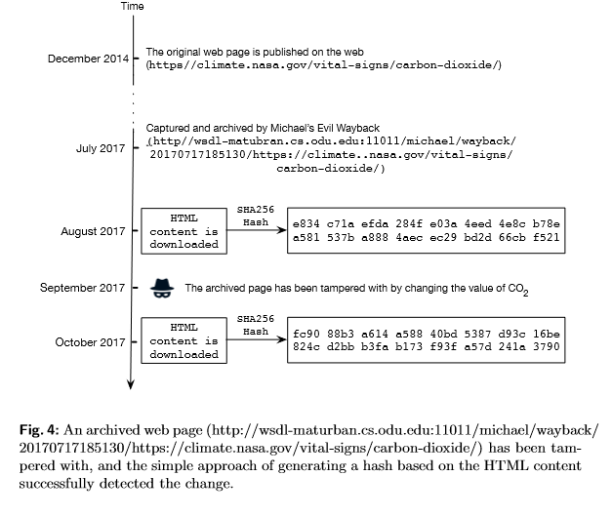
Tamper Detection using Hashing

Slide 9
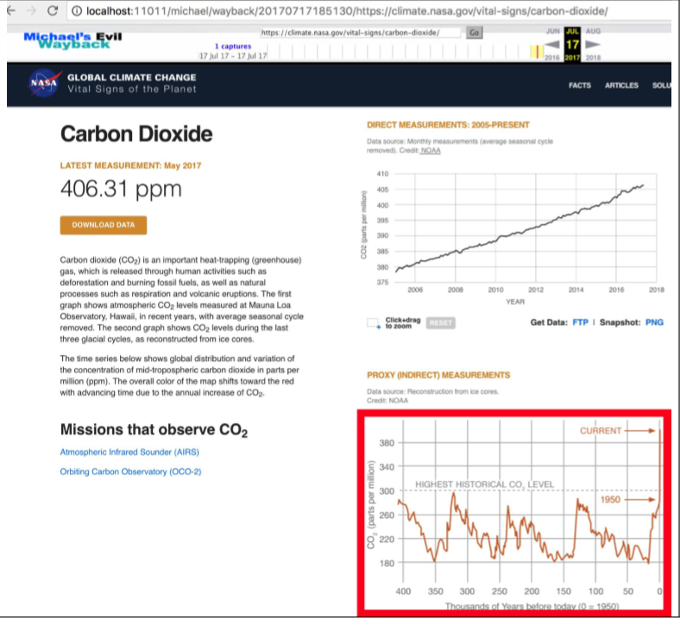
Issues that might arise from a composite Memento

Slide 10
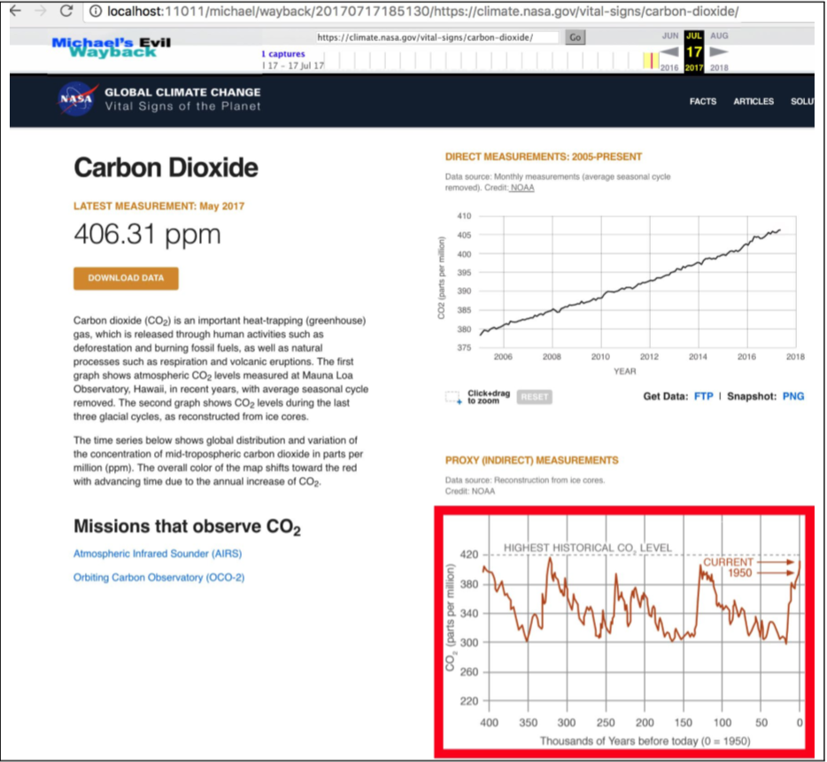
Risk of Changes in the Content

Slide 11
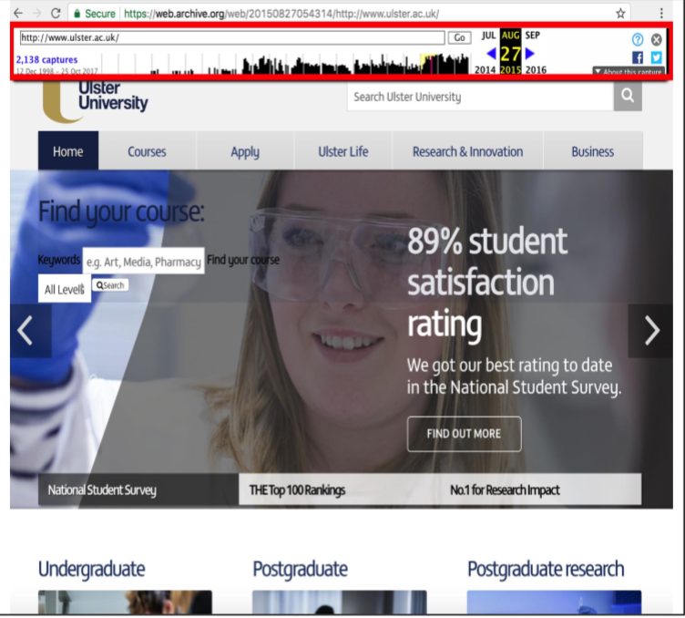
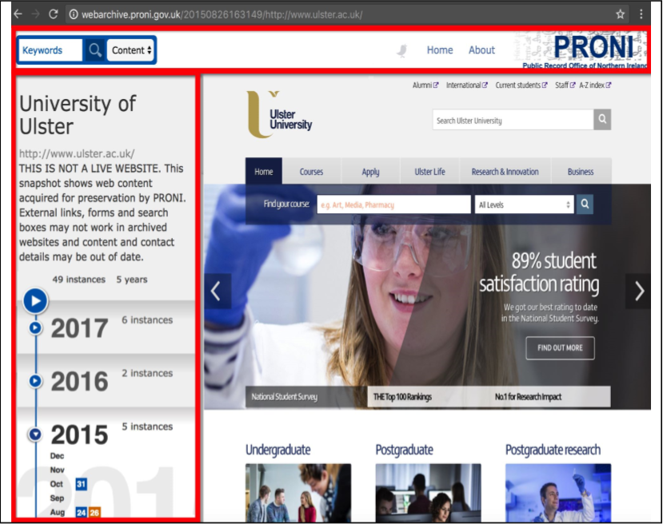
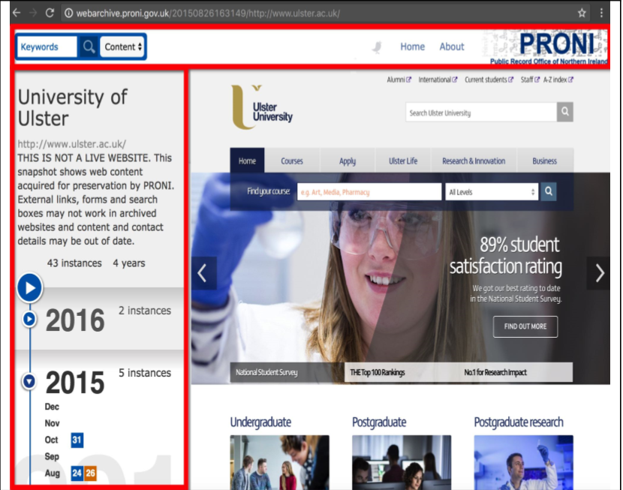
Archive Specific Content added to Mementos

Slide 12
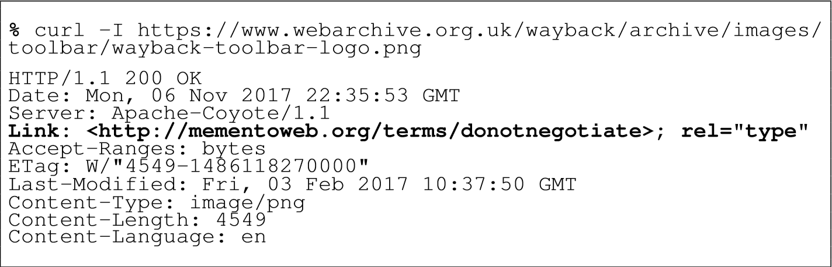
Response Headers Indicates Archive Specific Contents

Slide 13
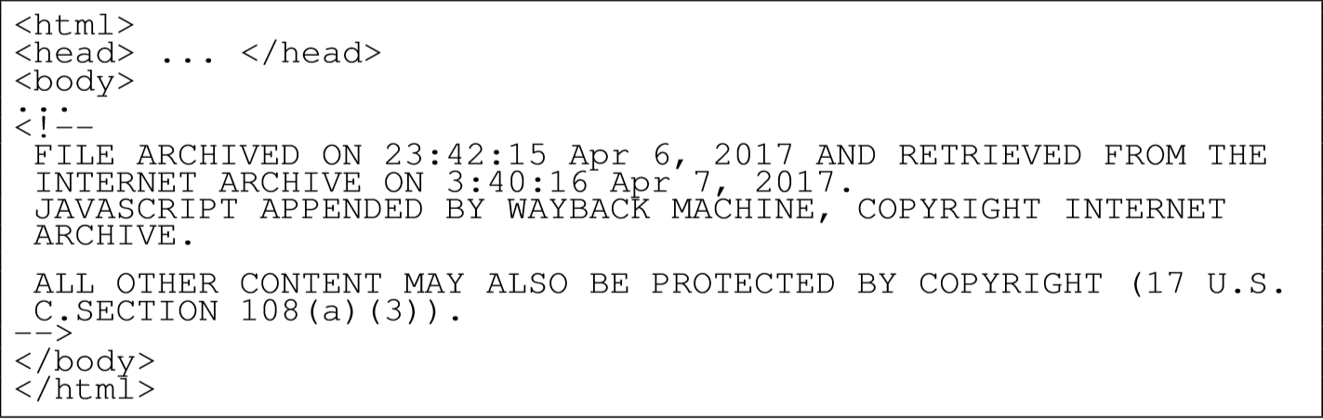
Comments added by the Internet Archive

Slide 14
Archive Specific Content
Links pointing to the resources in the Archive
Info indicating/identifying/advertising the Archive

Slide 15
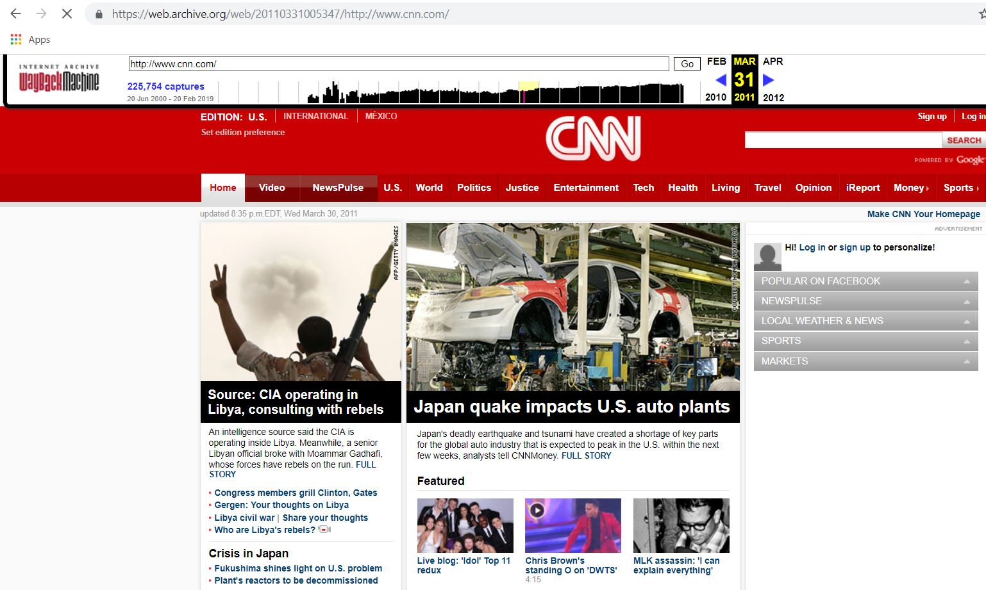
Sample Memento from CNN
Extracting raw data from Archive for a Memento is possible by adding id_ to the time stamp in the link

Slide 16
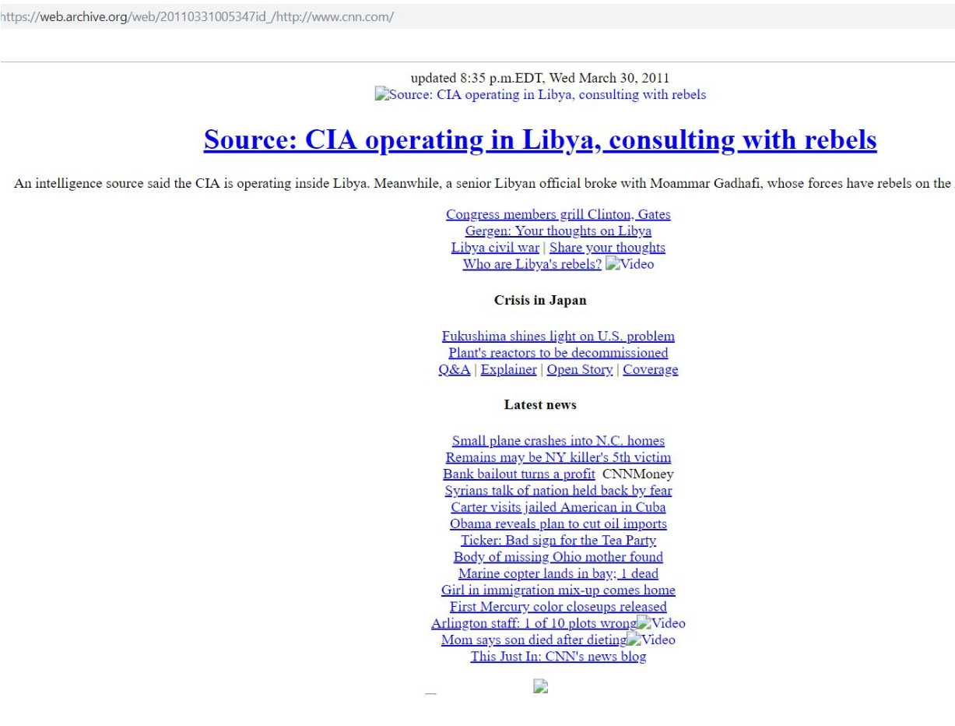
Can we Obtain the RAW data for a Memento ?
Yes we can .
Is the data always Good ?
Broken Links/Unavailable resources

Slide 17
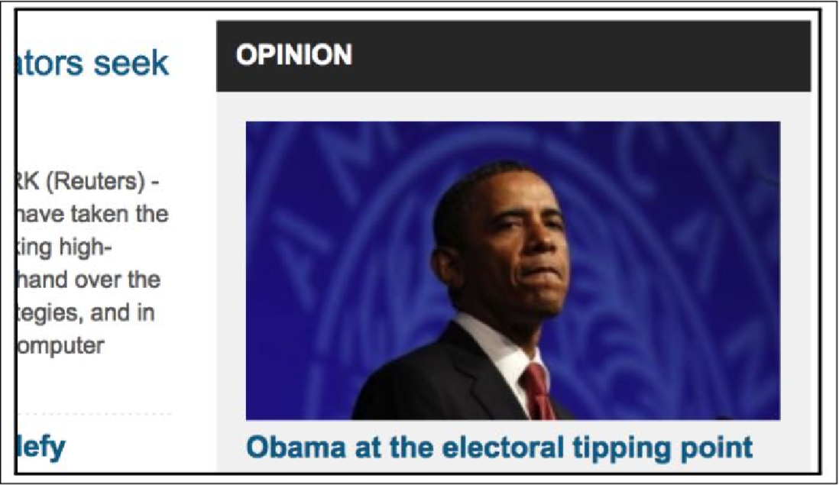
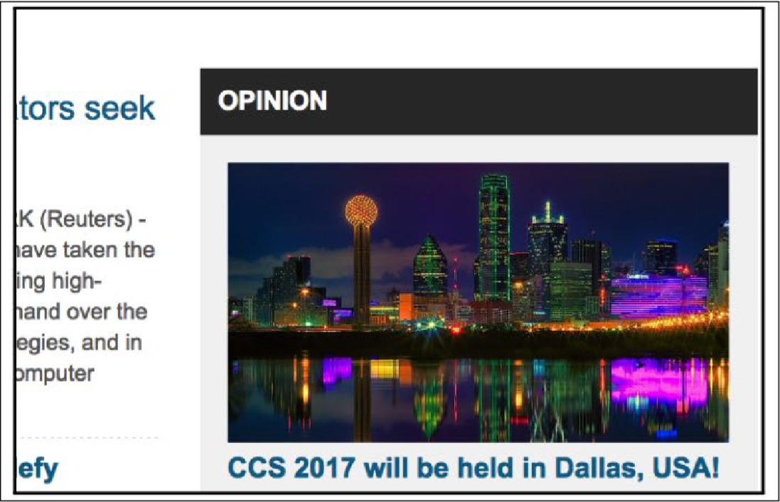
Data from Live Web
Data from Live Web changes periodically and any type of resources pointing to a Live Web changes

Slide 18
Excluding any resources from Live Web
Mementos might contain links to the live web that might load Images, Charts, Videos, any kind of Data from different sources that might change with time
Exclude them while computing Hash

Slide 19
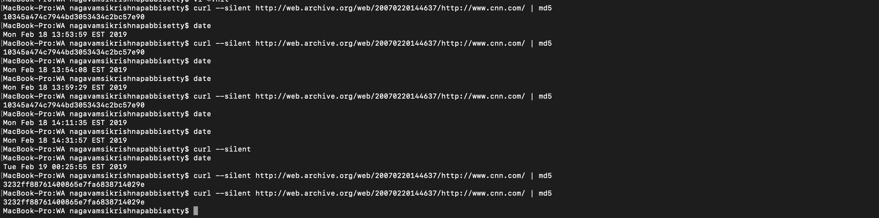
Archived Web pages might be served from a Cache

Slide 20
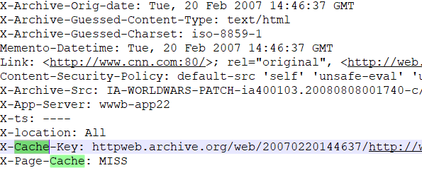
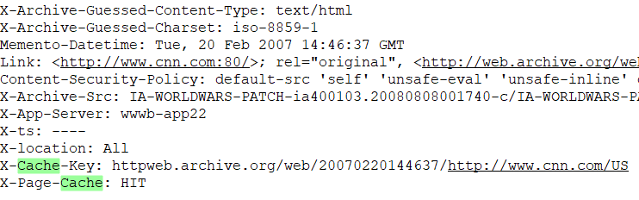
Archived Web pages might be served from a Cache

Slide 21
Mementos might be in Flux
Pages/Mementos/their resources available now might not be available in an hour
Pages/Mementos/their resources that are unavailable right now might be available in an hour
This produces different Hashes due to the Flux of the resources in the Archive

Slide 22
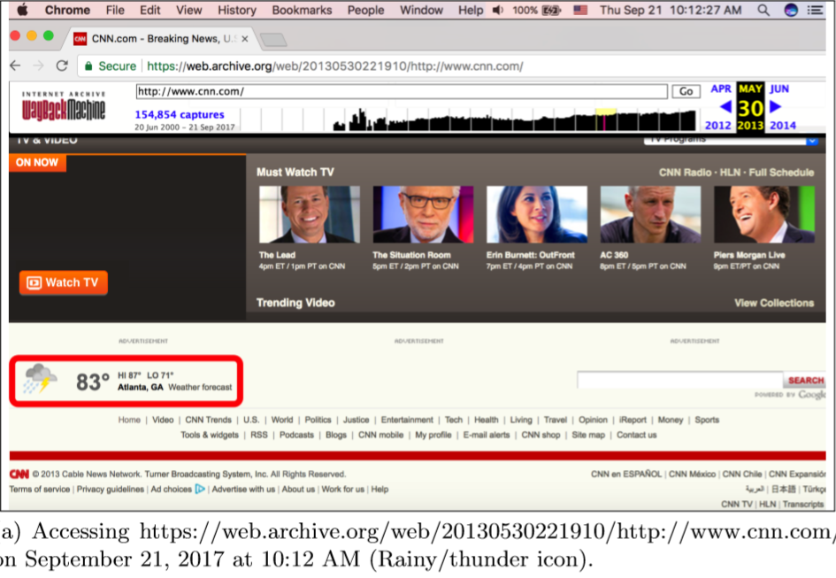
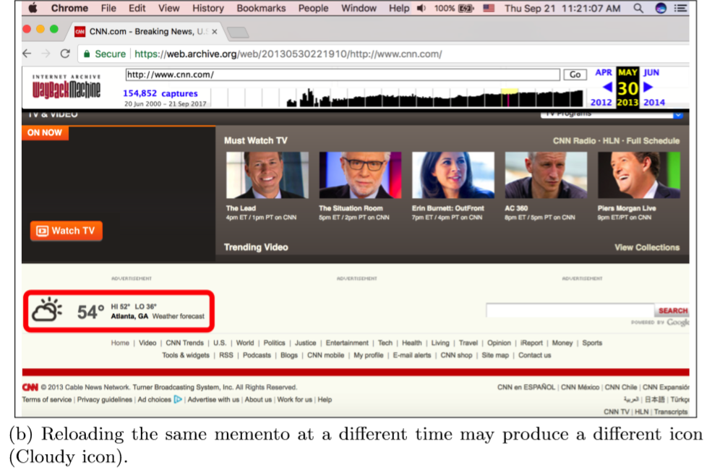
Java Script having its Fun(Dynamic Content on Web)

Slide 23
Information from Response Headers
HTTP response headers gives information regarding the state of the returned Page e.g., “X-Page-Cache” – source location of the Page
Another Example – “Content-Type”, “Location”
Using 4000 examples , Prof. Rosenthal implemented a proof-of-concept showing how an archive can migrate its resources from one MIME to another((e.g., image/gif to image/png) .

Slide 24
Conclusion
Avoid data from Live Web
Exclude Archive specific content
Be sure that the pages are not in flux
Do not include Dynamic content
Verify that the Memento is not from cache
Good to include few Response Headers into Hash Function

